Slide 1
Stellar Evolution
The life cycle of stars
Objectives:
Define various types of stars
Predict the outcome of a star’s cycle based upon mass

Slide 2
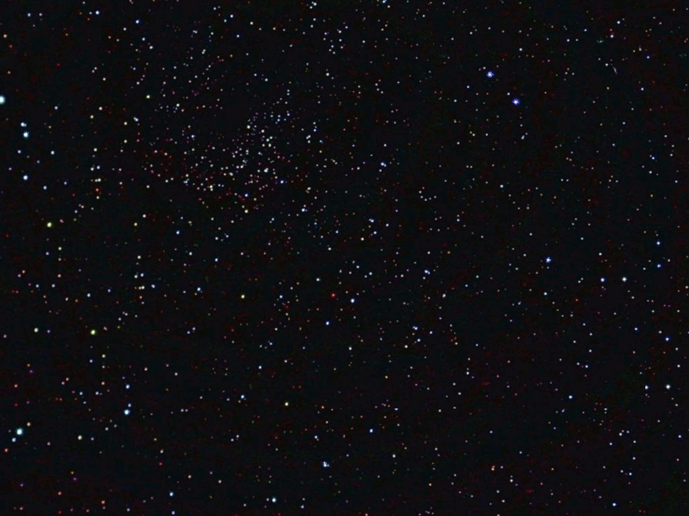
What does stellar evolution mean?
We see countless stars in the night sky and they usually look the same.
What we can’t really see is that these stars have been around for very long periods of time, progressing through a life cycle of sorts.
The image of a night sky is just a snapshot within this extremely long cycle.
The entire cycle of a star is called Stellar Evolution.
Stellar = of a star
Evolution = a process of development or change

Slide 3
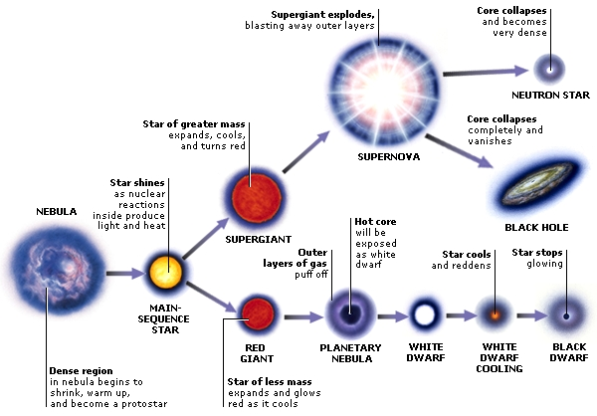
You are given a blank version of this that you will need to fill out.
NEUTRON & PULSAR STARS

Slide 4
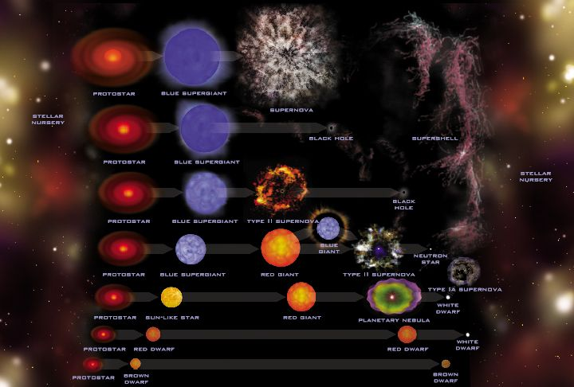
Different Cycles of Stars: Mass
Stars are formed by nebulae (“Stellar Nursery”)
Different nebulae have differences in the amount of gas they have to start with.
The mass of the star when it forms determines the particulars of the cycle a star goes through.
  Nebulae with little gas can form low-mass stars.
  Nebulae with more gas can form medium-mass stars.
  Nebulae with a lot of gas can form high-mass stars.

Slide 5
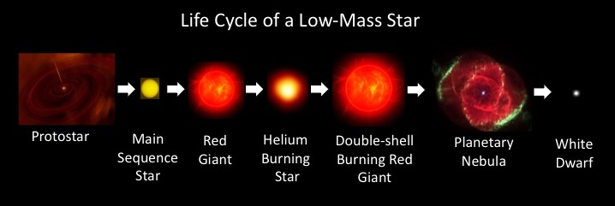
Overview:
The Life Cycle of LOW- & Medium-Mass Stars

Slide 6
Low-to-medium-mass stars LIFE CYCLE
Step 1: Small to medium cloud of gas.
  Starting from smaller nebular clouds, low-to-medium-density stars start as smaller clouds of gas.
Step 2: Protosun forms through gravity.
  When given proper initial momentum (from a nearby supernova for example) the cloud starts to spin and condense forming a protostar.
Step 3: Nuclear fusion causes light and energy to be released.
  The protostar continues to condense due to gravity, forcing collisions in the hydrogen atoms, increasing internal pressure and temperature to extremes, and causing nuclear fusion.
  Nuclear fusion happens in excess of 10,000,000°C!
Step 4: Stars enter its Main Sequence.
  With gravity (inward force) balanced against the nuclear fusion (outward force), stars enter a stabilization period called its main sequence.
  Roughly 90% of a star’s life, 10-100s of billions of years.
Step 5: Forms a Red Giant
  Main sequence persists as long as there is hydrogen to fuel nuclear fusion. When hydrogen runs out, gravity is greater than the fusion force and the core shrinks. Fusion occurs outside the core, causing the outer regions of the star to expand dramatically until it forms a red giant creating helium in the process.
Step 6: Forms Planetary Nebula
  Fusion in the now helium-core persists until the fuel (atoms) are used up. Gravity forces the helium into a core while the other matter surrounding the core is emitted to space as a cloud, forming a planetary nebula.
Step 7: Forms White Dwarf
  Once the nebula dissipates enough, the remaining core forms a white dwarf.

Slide 7
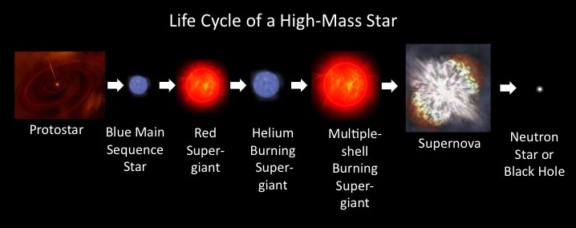
OVERVIEW:
The Life Cycle of High-Mass Stars

Slide 8
High Mass Life Cycle
Step 1: Large cloud of gas
  Starting from larger nebular clouds, high-density stars start as large clouds of gas.
  High-mass stars start with at least 8 times more matter than our sun.
Step 2: Forms protosun.
  When given proper initial momentum (from a nearby supernova for example) the cloud starts to condense forming a protostar.
Step 3: Nuclear fusion causes light and energy to be released.
  The protostar continues to condense due to gravity, forcing collisions in the hydrogen atoms, increasing internal pressure and temperature to extremes, and causing nuclear fusion.
Step 4: Stars enter its Main Sequence.
  With gravity (inward force) balanced against the nuclear fusion (outward force), stars enter a stabilization period called its main sequence.
Step 5: Forms into a SUPER Red Giant
  Main sequence persists as long as there is hydrogen to fuel nuclear fusion. When hydrogen runs out, gravity is greater than the fusion force and the core shrinks. Fusion occurs outside the core, causing the outer regions of the star to expand dramatically, creating heavier elements in the process.
Step 6: Produces a Supernova
  Fusion in the now helium-core persists until the fuel (atoms) are used up. Gravity forces the helium into a core while the other matter surrounding the core explodes into space, crating heavier elements in the process.
Step 7: Black Hole or Neutron Star forms
  Masses > (greater than) 3x greater than the sun → the core implodes into a Black Hole
  Masses < (les than) 3x greater than the sun → the core forms a Neutron Star.

Slide 9
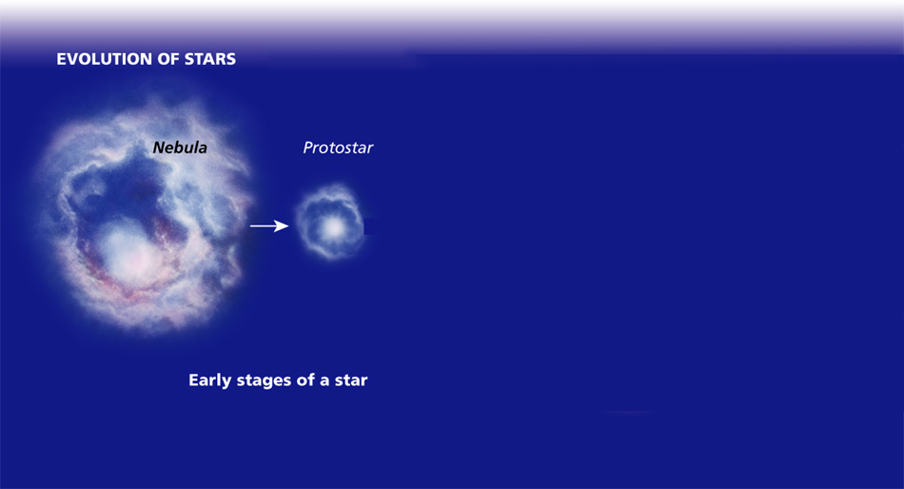
Stellar Evolution

Slide 10
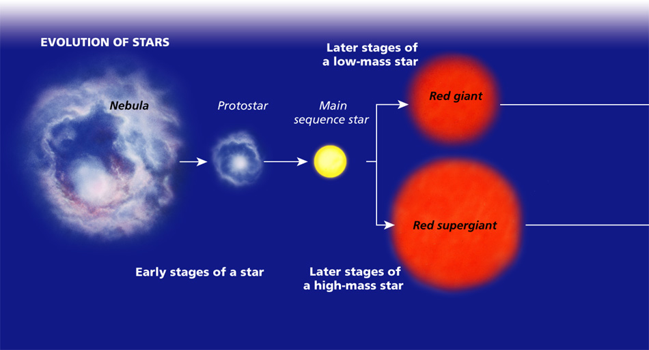
Stellar Evolution

Slide 11
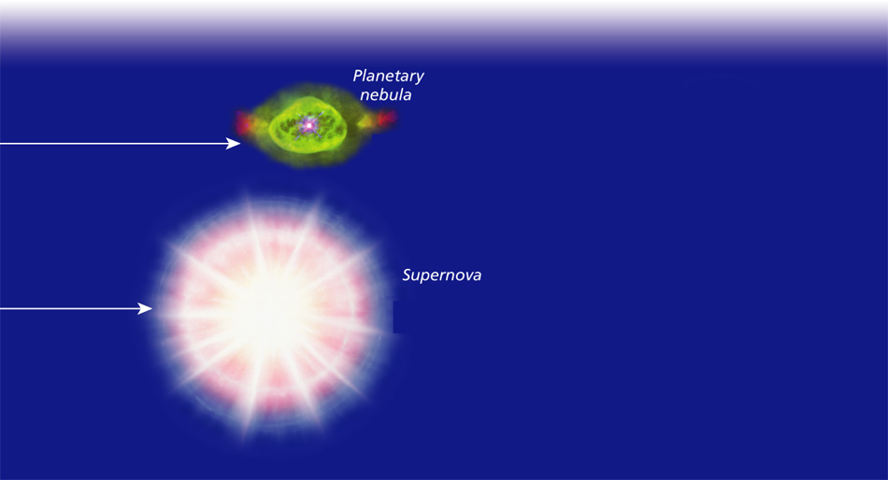
Stellar Evolution

Slide 12

Stellar Evolution

Slide 14
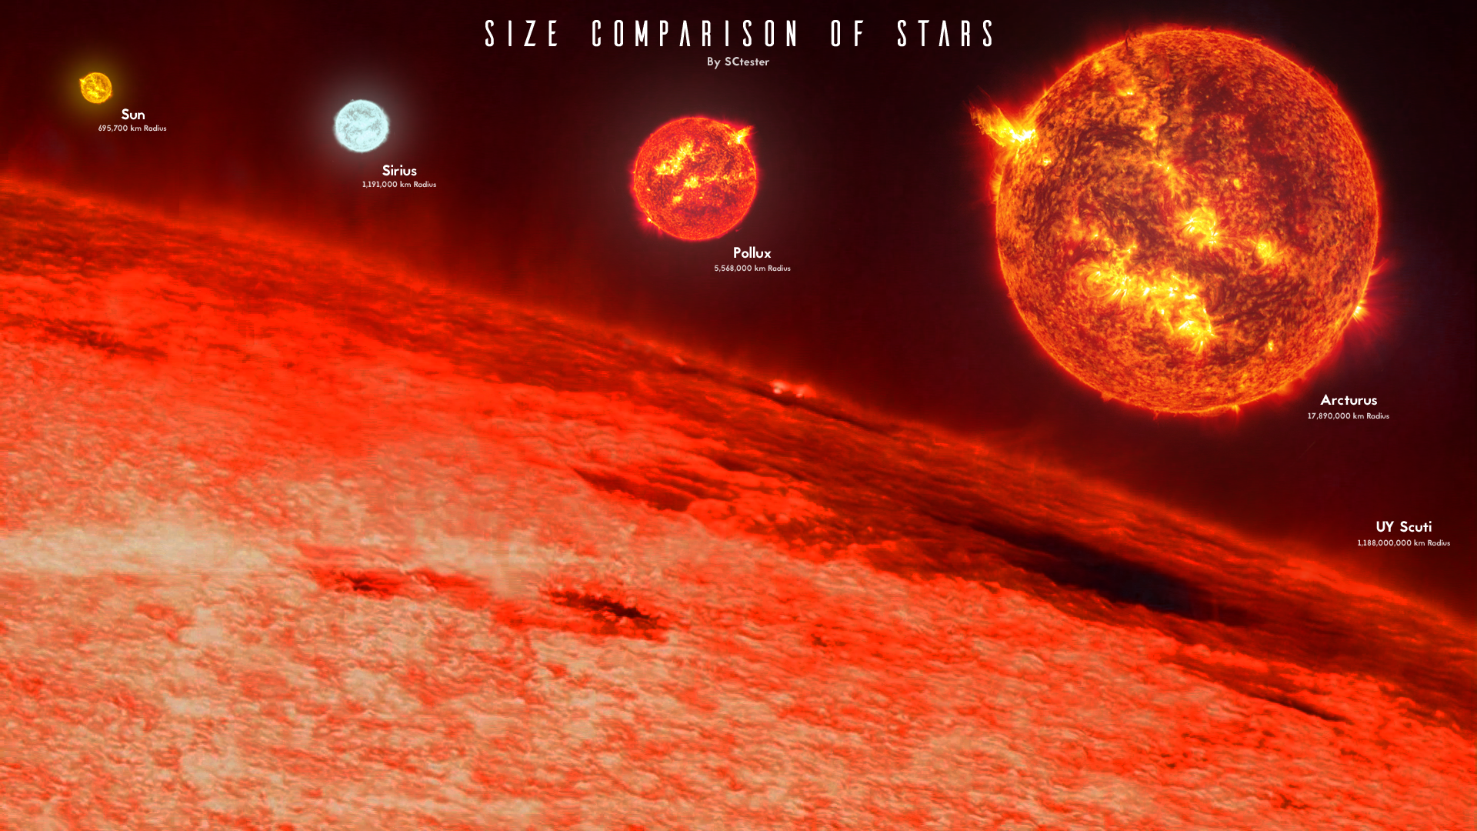
Size Comparison amongst 5 stars

Slide 15
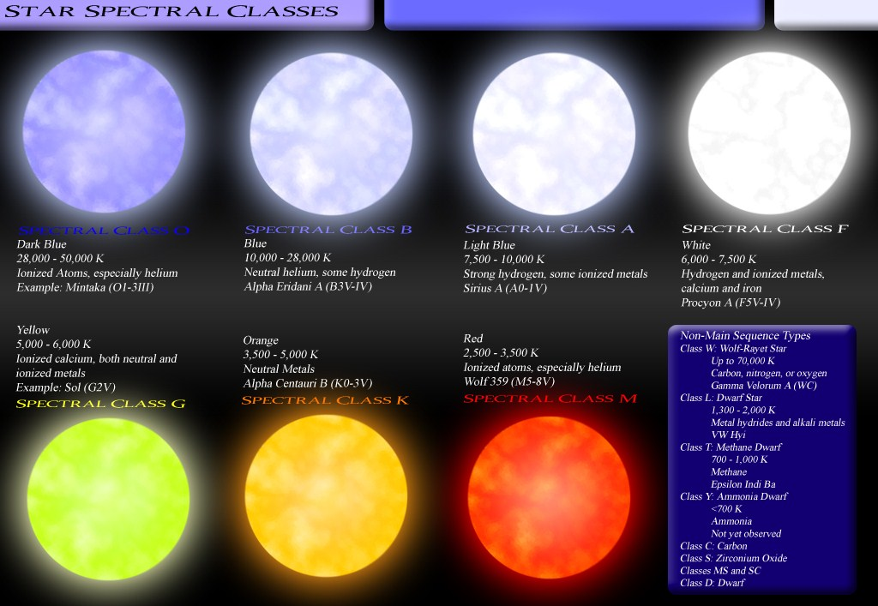
Color comparison between different star classes

Slide 16
Comparing LOW-&-Medium-Mass stars to High-Mass Stars
Feature | High Mass | Low-to-medium Mass
Mass, compared to the Sun | More than 8x larger than the sun | 1/10 – 8 times the mass of the sun
Length of life cycle | Millions of years | 10-100 billions of years
Features of life cycle | Hotter, brighter, faster | Cooler, dimmer, longer
Elements produced | Up to iron (#26 on PTE) (Super-high-mass produces bigger) | Hydrogen and helium
Color of Main Sequence | Blue | Yellow or red
End product | Neutron star or Black hole | White Dwarf

Slide 17
Fill in this chart.
Theoretical. It takes 20 billion years to form & the universe isn’t that old.

Slide 18
You are given a blank version of this that you will need to fill out.
NEUTRON & PULSAR STARS

Slide 19
Stellar Evolution Poster: 15pt EC
To practice studying stellar evolution, you and your group will produce a large scale flow chart version of the chart you filled out. Note. Your flow chart will not be exactly the same as the chart. The chart you filled out is a reference to diagram each of the sequences separately (with different beginnings). Start with a large piece of butcher paper and (with a small line) separate it into an upper and lower section. The upper section will be for the stellar evolution of a LTM-mass star, and the lower section will be for a high-mass star. Note when it’s due.
Poster requirements:
  On a white background.
  Steps 1-8 diagramed for Low-to-Medium-mass Stars
  Steps 1-8 diagramed for High-mass Stars.
  Must include accurate colors for each stage
  Must be neat

